Slide 1
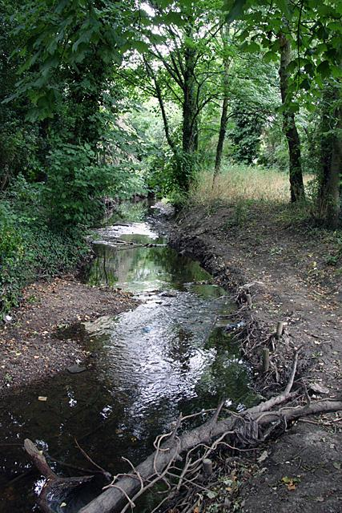
Do Now
Silt
Current
Brook
Try to write a sentence using one, or more, of these words. Remember, it is okay to guess what they mean, since we haven’t studied them yet.
Notes:
🍐 This is a Pear Deck Text Slide
🍐 To edit the type of question, go back to the "Ask Students a Question" in the Pear Deck sidebar.

Slide 2
Learning Targets
• I can determine the main idea of “River to the Sea.
• I can determine the key details of “River to the Sea.
• I can describe connections between sentences in “River to the Sea” and how they support the key details and main idea.
Notes:
🍐 This is a Pear Deck Text Slide
🍐 To edit the type of question, go back to the "Ask Students a Question" in the Pear Deck sidebar.

Slide 3
What do you know about the word distract?
Notes:
🍐 This is a Pear Deck Text Slide
🍐 To edit the type of question, go back to the "Ask Students a Question" in the Pear Deck sidebar.

Slide 4
Distract is the verb, or the action.
Distractors are those things or people that distract you.
If you are supposed to be doing your homework and your little brother keeps bugging or distracting you, your brother is a distractor.
If it’s your older sister’s music that is keeping you from doing your homework, the music is the distractor.
Sometimes there are distractors in text or pictures that keep you from accurately determining the main idea. As you read this text, it will help you to look out for words and pictures that distract from the main idea. Often writers include lots of information that is interesting but not central to their main point.
How might you avoid getting distracted?
Notes:
🍐 This is a Pear Deck Text Slide
🍐 To edit the type of question, go back to the "Ask Students a Question" in the Pear Deck sidebar.

Slide 5
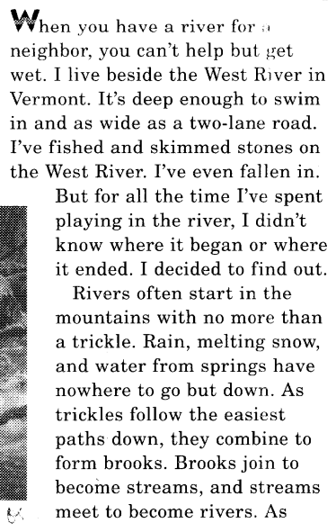
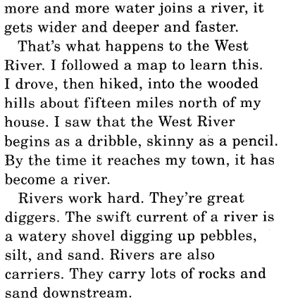
Highlight the key details of this text (the most important information).
Circle words that show comparison (information that is similar).
Notes:
🍐 This is a Pear Deck Drawing Slide
🍐 To edit the type of question, go back to the "Ask Students a Question" in the Pear Deck sidebar.

Slide 6
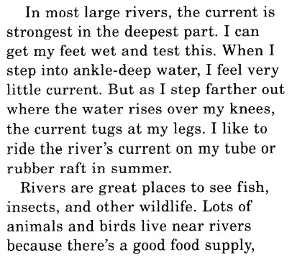
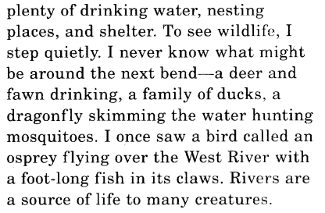
Highlight the key details of this text (the most important information).
Circle words that show comparison (information that is similar).
Notes:
🍐 This is a Pear Deck Drawing Slide
🍐 To edit the type of question, go back to the "Ask Students a Question" in the Pear Deck sidebar.

Slide 7
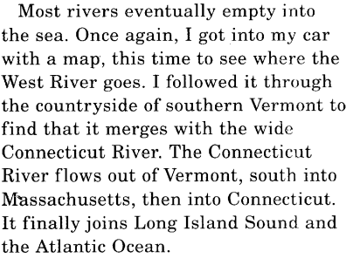
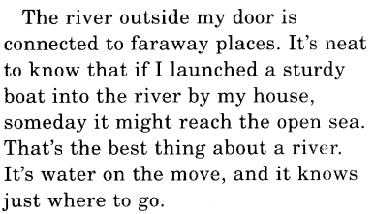
Highlight the key details of this text (the most important information).
Circle words that show comparison (information that is similar).
Notes:
🍐 This is a Pear Deck Drawing Slide
🍐 To edit the type of question, go back to the "Ask Students a Question" in the Pear Deck sidebar.

Slide 8
In your own words, what is the main idea of this text?
Notes:
🍐 This is a Pear Deck Text Slide
🍐 To edit the type of question, go back to the "Ask Students a Question" in the Pear Deck sidebar.

Slide 9

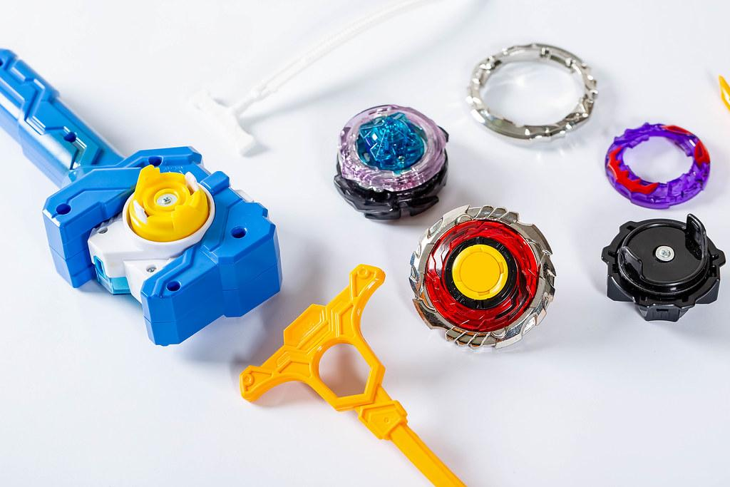
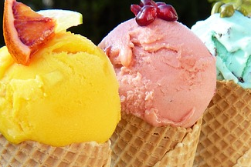
We will make connections between sentences, but this time we will look for sentences that are connected in a different way.
Instead of explaining a sequence or order, these sentences will make a comparison.
The word comparison comes from another word, its root word, compare.
Compare means to describe what is alike, or similar, and what is different about two things.
You might compare two video games when deciding which to buy. Or you might compare the flavors of two kinds of ice cream.
What else could you compare?
Notes:
🍐 This is a Pear Deck Text Slide
🍐 To edit the type of question, go back to the "Ask Students a Question" in the Pear Deck sidebar.

Slide 10
“Rivers often start in the mountains with no more than a trickle.”
“As more and more water joins a river, it gets wider and deeper and faster.”
“How are these sentences connected?”
“What words in these sentences make the comparison, or what is alike and different, clear to the reader?”
Notes:
🍐 This is a Pear Deck Text Slide
🍐 To edit the type of question, go back to the "Ask Students a Question" in the Pear Deck sidebar.

Slide 11
Rivers and Streams Text
Rivers and Streams Main Idea Assignment
In your own words, what is the main idea of this text?
Write your main idea statement.
Your main idea statement should:
It should address all the major sections of the text.
It should pull together the most important ideas.
It should be short, only one or two complete sentences.
Notes:
🍐 This is a Pear Deck Text Slide
🍐 To edit the type of question, go back to the "Ask Students a Question" in the Pear Deck sidebar.

